Slide 1
Project Scope and Introduction
Background:
On page 5 of The Destructionists (2022), Washington Post columnist Dana Millibank wrote: “Republican lawmakers and opinion leaders, amplified by Fox News, have overwhelmingly succeeded in deterring their followers from getting the Covid-19 vaccine by promoting disinformation about imagined dangers of the inoculations. As a result, the Covid death rate in the most pro-Trump decile of America (as measured by counties’ vote share for Trump in 2020) is now nearly six times [original emphasis] the death rate in the most anti-Trump decile.”
Millibank does not cite a source for the latter claim concerning COVID-19 mortality differences by county vote totals in the 2020 presidential election. Having previously queried CDC COVID-19 mortality/hospitalization data and 2020 electoral outcomes data, I decided to create a short project in SQL and R to evaluate Millibank’s claim: COVID-19 death rate—presumably measured by per capita death attributable to SARS-Cov-2 infection—among counties in the top decile of GOP-voting counties during the 2020 presidential elections was 600% of the top decile of Democrat-voting counties during the same election.
Results:
Publicly available data covering demographic, public health, and presidential vote-count totals for each US county do not support Millibank’s latter claim. Regarding the former claim—that conservative political messaging deterred GOP voters from receiving the COVID-19 vaccine—there is some evidence to suggest a relationship between county-level voting behavior and vaccination rates among all studied age groups. That relationship, however, is not statistically significant according to the methods of analysis employed by this project. Neither should any claim of one-directional causality be justified solely by the observation of non-significant correlation.

Slide 2
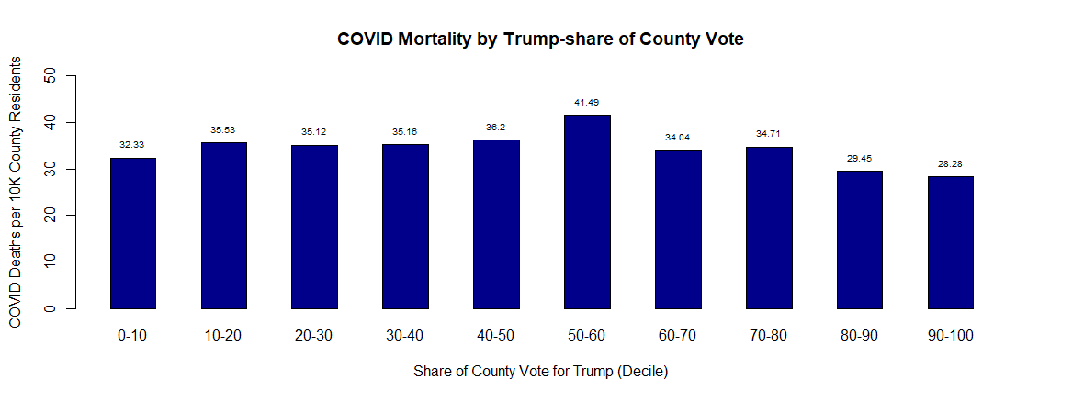
COVID Mortality Rate, Mortality Rate from all Causes, and Median Age

Slide 3
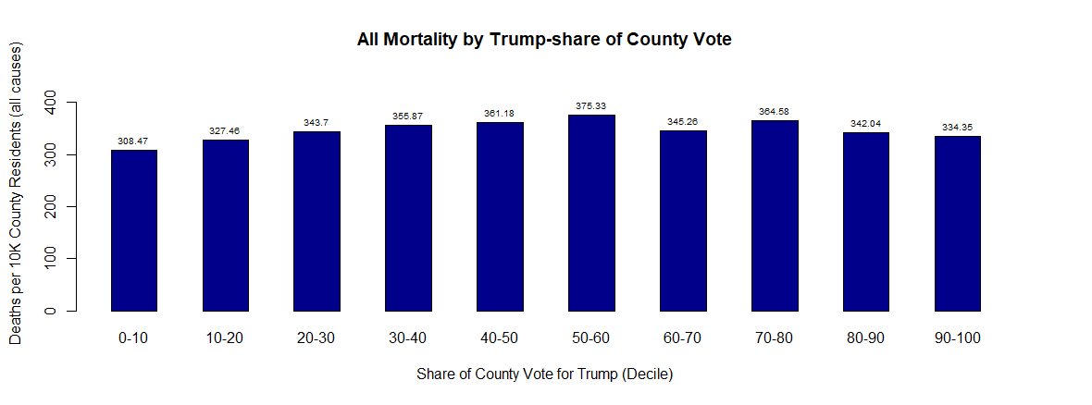
COVID Mortality Rate, Mortality Rate from all Causes, and Median Age

Slide 4
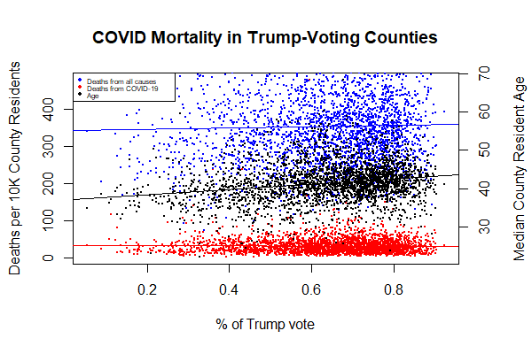
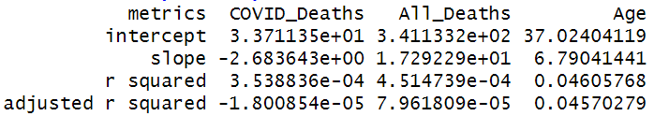
COVID Mortality Rate, Mortality Rate from all Causes, and Median Age

Slide 5
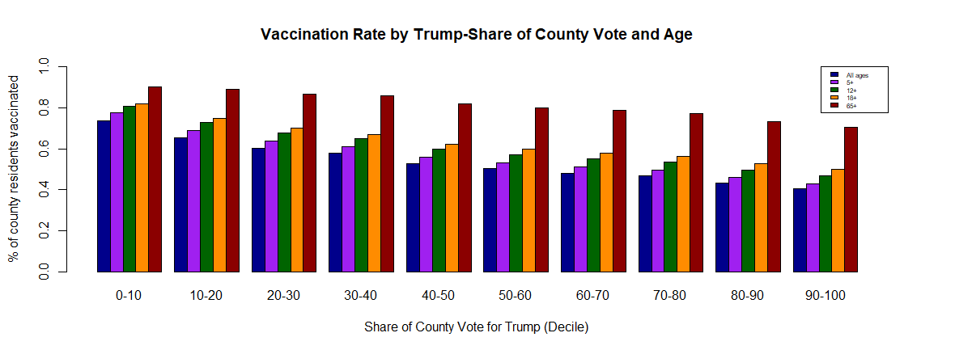
COVID-19 Vaccination by Age and Voting Behavior

Slide 6
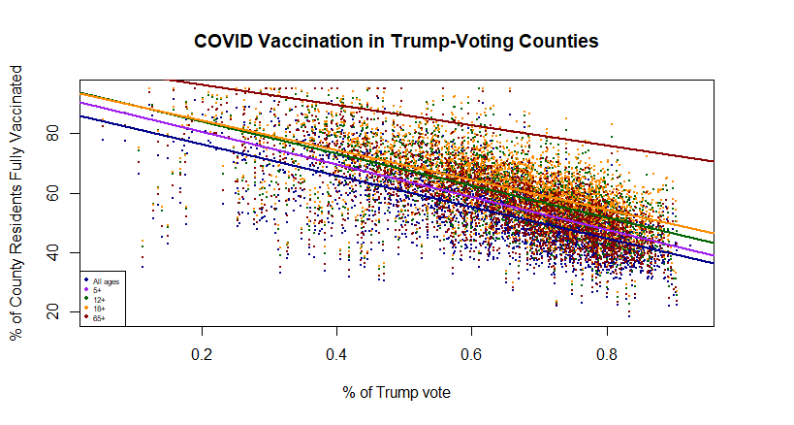
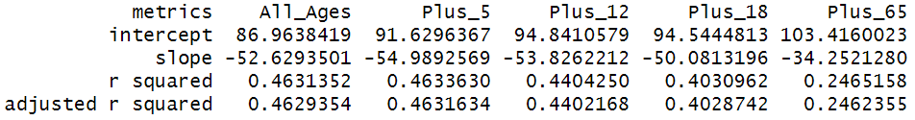
COVID-19 Vaccination by Age and Voting Behavior

Slide 7
Source Data
CDC COVID-19 Death Data and Resources
CDC COVID-19 Vaccinations in the United States, County
US Census Bureau County Population by Characteristics: 2020-2021
GitHub: tonmcg/US_County_Level_Election_Results_08-20

